Slide 1
Bash Shell Command
Week 2
Linux Command Line and Shell Scripting Bible, 3rd Edition

Slide 2
Overview
Interacting with the shell
Traversing the filesystem
Managing files and directories
Viewing file contents
Managing processes
Managing disks
Sorting and archiving data

Slide 3
Commands and Topics
Interacting with the shell
man, help, info
Traversing the filesystem
cd, pwd, ls, touch
Managing files and directories
cp, ln, mv, rm, mkdir, rmdir
Viewing file contents
file, cat, echo, more, less, head, tail
Managing processes
ps, top, kill, killall
Managing disks
mount, umount, df, du
Sorting and archiving data
sort, wc, grep, gzip, tar

Slide 4
Getting Additional Information about Commands
Use the help command.
Example: help echo
Use the --help command option.
Example: date --help
Use the info command.
Example: info date
Use the man command.
Example: man date or man -k date

Slide 5
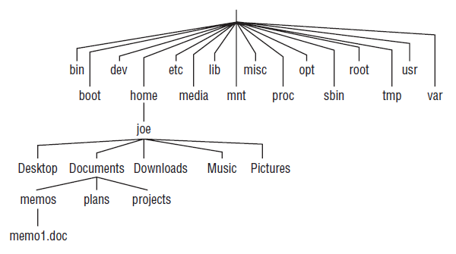
Filesystem Directory Hierarchy
Files are organized within an upside-side down tree directory hierarchy.

Slide 6
A few common Linux Directories
/bin - common Linux user commands.
/etc - administrative configuration files.
/home - regular users’ home directories.
/root - root user’s home directory.
/sbin - administrative commands.
/tmp - temporary files.

Slide 7
The cd command
Change to another directory
Going home
Can be used with no options to go to home directory. Example: cd
Can be used with tilde (~) to go to home directory Example: cd ~
Go to sub-directory of the home directory with tilde. Example: cd ~/CS2080

Slide 8
Directory Path Names
Absolute path name directory name
Also called “Full path name.”
Always begins with slash (/)
Example: cd /usr/share
Relative path name directory name
Never beings with a slash (/)
Example: Go to the doc subdirectory of the current working directory, /home/joe cd doc

Slide 9
Identifying Directories
$HOME
Stores your home directory name
Example: cp /home/joe/doc/memo.txt $HOME
Tilde (~)
Represents your home directory
Example: cp /home/joe/doc/memo.txt ~
Single dot (.)
Represent current working directory
Example: cp /home/joe/doc/memo.txt .
Two dots (..)
Represents directory above the current working directory
Example: cd ..

Slide 10
File-matching Metacharacters
To refer to a group of files or directories.
* Matches any number of character.
? Matches any one character.
[. . .]
Matches any of the characters between brackets.
Can include hyphen-separated letter or number ranges.

Slide 11
The pwd command
Prints the name of the current working directory
Also called the “present working directory”.
Example: pwd /home/joe
Determine the effects of the cd command.
Example: cd ../christine pwd /home/christine

Slide 12
Listing Files and Directories
The ls command is the most common command used to list information about files and directories.
A few options available with the ls command.
The -a option shows hidden and non-hidden files
The -F option shows the files and appends a file-type indicator
The -l option (lowercase L) produces a long listing .
The -R option lists all files and directories recursively from the current directory downward.

Slide 13
Copying Files
The cp copies a file to a new file. Example: cp file file.bck
The cp copies a file to a new location. Example: cp file /home/joe/Documents/

Slide 14
Moving & Renaming Files
The mv command can change the location of a file. Example: mv file /home/joe/Documents/
The mv command can rename a file. Example: mv file newfile

Slide 15
The mkdir command
Creates a directory.
Only can create directories where have permission to do so.
Create directory using absolute path name. Example: mkdir /home/joe/test
Create directory using relative path name. Example: pwd /home/joe mkdir test

Slide 16
Removing Files & Directories
The rm command deletes a file. Example: rm file
The rmdir command deletes an empty directory. Example: rmdir /home/joe/temp
The rm -r command deletes a non-empty directory & all its files and subdirectories. Example: rm -r /home/joe/Documents

Slide 17
Links
Hard link and soft link
Hard link cannot refer to a directory & within its own filesystem
Soft link can point to a nonexistent file
$ ln -s hello hello.sl
$ rm hello
$ echo “new” > hello
$ cat hello.sl
new

Slide 18
Basic File Operations
Read files ( cat )
cat /home/joe/practice
cat /etc/motd
Some files are not readable (e.g., binary)
cat /bin/cat

Slide 19
Basic File Operations
Write/create files ( echo )
ls
echo “hello world” > hello
ls
cat hello
echo “I am your name” >> hello
cat hello
cat hello hello

Slide 20
Basic Utilities
Identify file types ( file )
file linux
file hello
file /home/joe/months
file /home/joe/uccs.png

Slide 21
Listing Processes with ps
Most common utility for checking running processes.
The ps u command shows info such as:
Username (USER)
Process ID (PID)
Time process began to run (START)
Cumulative system time used (TIME)
Associated command (COMMAND)

Slide 22
Additional Information with ps
The ps ux command shows
all processes running on the Linux system,
for the current user.
The ps aux command shows
all processes running on the Linux system,
for all users.

Slide 23
Additional ps options
-e Show every running process on system.
-o ‘item1,item2,…itemN’ Show the listed items in the display.
--sort=item Show the list sorted by item

Slide 24
Listing Processes with top
The top command
Provides Screen-oriented display.
Shows processes running on your system.
The default displays processes based upon how much CPU time they are currently consuming.

Slide 25
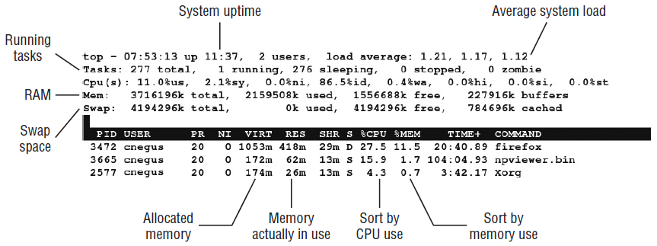
Display Running Process with top

Slide 26
The top command actions
Press q to quit top.
Press h to see help options.
Press M to sort display by memory usage.
Press P to soft display by CPU usage.
Press R to reverse the sort order.
Press u to enter a username for displaying their processes.
Press 1 to toggle between CPU usage for all system CPUs.

Slide 27
Killing Processes
The kill and killall command
send a signal to the process telling it to end.
can also send any valid signal to a process.
Signals are represented by either
name (ex: SIGHUP) or
number (ex: 1)
Different processes respond to different signals.
Process cannot block SIGKILL and SIGSTOP.

Slide 28
Using kill to Signal Processes by PID
Find the Process ID using ps or top
Type: kill -signal PID
The default kill signal is 15 (SIGTERM). Will be used if signal is not included in command.
The signal can be the signal name or number.
Examples:
kill 10432
kill -15 10432
kill -SIGKILL 10432

Slide 29
Using killall to Signal Processes by Name
The killall command can signal process by name instead of by PID.
Danger: Might kill more processes than intended if not careful!
Syntax: killall -signal ProcessName
Example: killall -9 testme

Slide 30
Kill with top
Kill a process with top
Note desired PID
Press k
At “Kill PID with signal [15]:” prompt, type 15 or type 9

Slide 31
Using the mount Command to Mount Filesystems
Typically only used to do two items
To display what is currently mounted, (type mount).
To temporarily mount a filesystem.
Mount a read-only ext3 filesystem disk partition:
Mount an already mounted filesystem with new options:

Slide 32
Mounting a Disk Image in Loopback
Used for
copying or installing software
from a downloaded media disk image
without having to create the media.
Example: Mount a CD iso image

Slide 33

Using the umount Command
Detaches the device or filesystem from its mount point in the Linux filesystem.
Directory name example:
Device name example:

Slide 34
Checking System Space
Displaying system space with df.
Checking disk usage with du.

Slide 35
Displaying system space with df
df no options Displays amount of space available on all mounted filesystems.
df -h Displays space available in a more human-readable format.
df –t TYPE Displays only filesystems of a particular type.
df –x TYPE Excludes filesystems of a particular type.

Slide 36
More df Options
df -a Include filesystems that have no space, such as /proc.
df -i List only available and used inodes.
df --block-size=# Displays disk space in certain block sizes.

Slide 37
Checking Disk Usage with du
Displays how much space is being consumed by a particular directory and its subdirectories.
Example:
du
du –h
du –h $HOME

Slide 38
Basic Utilities
sort, wc |(pipe)
sort file| head -5
wc -l file, wc –c file
gzip, tar
What’s the difference?

Slide 39
Searching in Files with grep
Used to search for files that contain a certain search term.
Can search
a single file
a whole directory structure of files recursively
Returned items can be
every line in a file containing the search term.
just the names of the files containing the search term.

Slide 40
The grep Command options
grep options:
-i to search for search terms ignoring case.
-l lists the files that include the search term, not the actual lines of text.
-r to perform recursive searches
-v search for lines that do not contain the search term.
Examples
grep desktop /etc/services
grep -i desktop /etc/services
grep -v desktop /etc/services

Slide 41
Introduction
Course Content
Week 1 - Intro UNIX/Linux
Week 2 - Bash Shell Command
Week 3 - Subshells & Variables
Week 4 – Permissions, Filesystems, & Software Management
Week 5 - Editors & Basic Scripts
Week 6 - Structured Commands
Week 7 - User Input & Output
Week 8 - Scripting & Functions
Week 9 - sed, gawk, & Regular Expressions
Week 10 - Make Files (more - as time allows)

